Slide 1
https://studentaid.gov/fsa-id/create-account/launch

Slide 2
Go to www.studentaid.gov and click on "Create an Account“
Scroll down and click on "Get Started“
Enter your legal name, date of birth and social security number. Make sure this information matches your social security card
Create a username, and password and enter your email. ATTENTION STUDENTS: DO NOT use your high school email address, as it may not be active after you graduate
Enter your home address and mobile phone. Select "Yes, I want to use my phone for account access“
Select 4 challenge questions from the drop-down menus
Review the information you've entered
Complete the 2-step verification using your mobile phone and email
Starting during the 2024-25 FAFSA, your FSA ID will need to be verified before you can access the FAFSA application. Once the Social Security Administration verifies your information in one to three days, you will have full access to www.studentaid.gov.

Slide 3
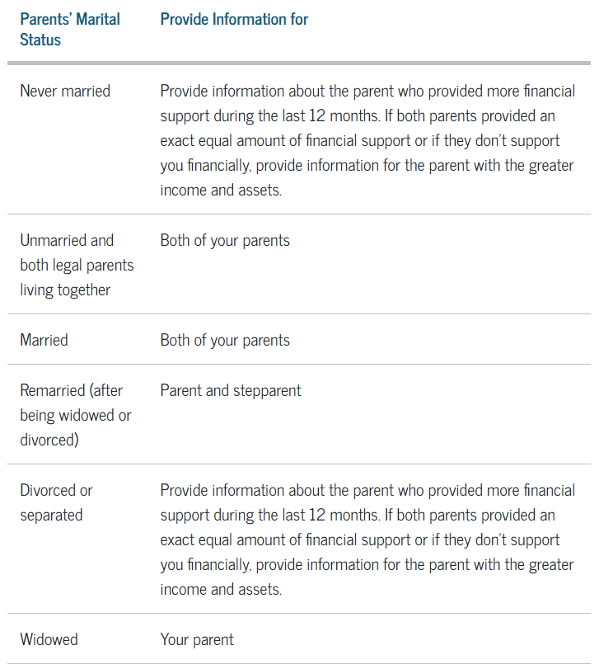
P

Slide 4
Contributor is a new term – it refers to anyone who is required to provide their information and signature on the FAFSA form
The parent wizard on the FAFSA form will offer a series of filtering questions that determine which parent of the dependent student will need an invitation to be a contributor
Students will be able to include up to 20 colleges (double the previous limit)
The save key has been eliminated
Demographic questions about the student’s gender, race, and ethnicity have been added and are for research only and do NOT affect federal student aid eligibility

Slide 5
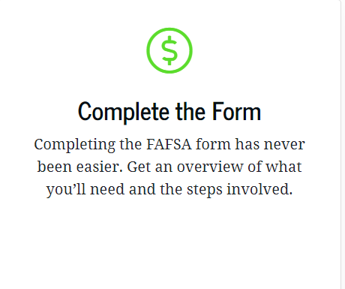

Slide 6
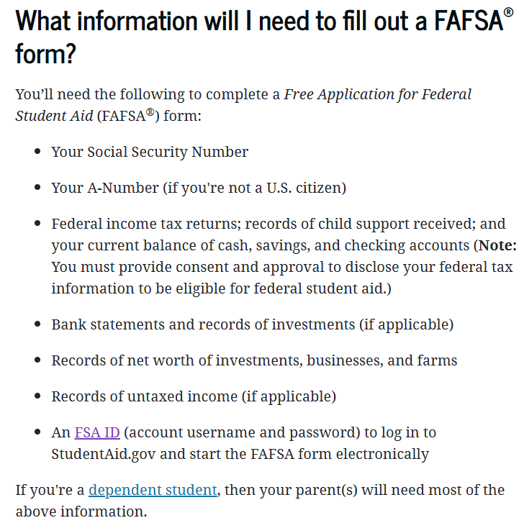

Slide 7
The Better FAFSA will offer you and your family a more streamlined experience that may only require you to complete as few as 18 questions in 10 minutes or less. The Better FAFSA will also expand access to financial aid for many, with as many as 610,000 new students eligible to receive Federal Pell Grants. So, even if you think you don't qualify for financial aid, you should still complete the FAFSA. Ten minutes can help save you thousands of dollars in paying for your education.

Slide 8
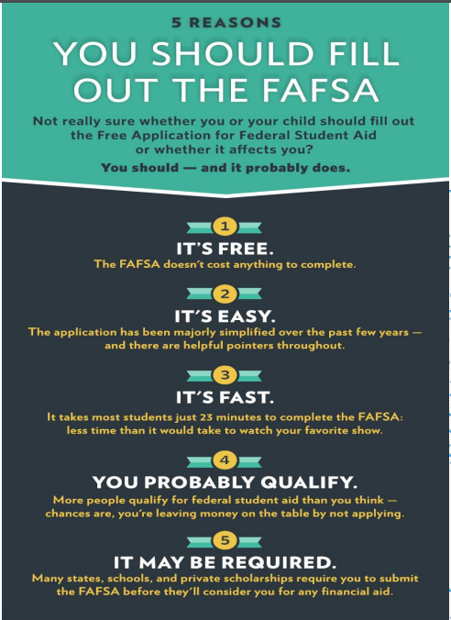
https://www.icansucceed.org/media/cms/ICAN__Why_File_the_FAFSA_FA86A4D60FA2E.pdf

Slide 9
FAFSA is the only way to qualify for Federal Loans, and if you could qualify for a forgiveness loan in the future this is the only way you will be able to benefit from the forgiveness opportunity. Private loans do not qualify for forgiveness.

Slide 10
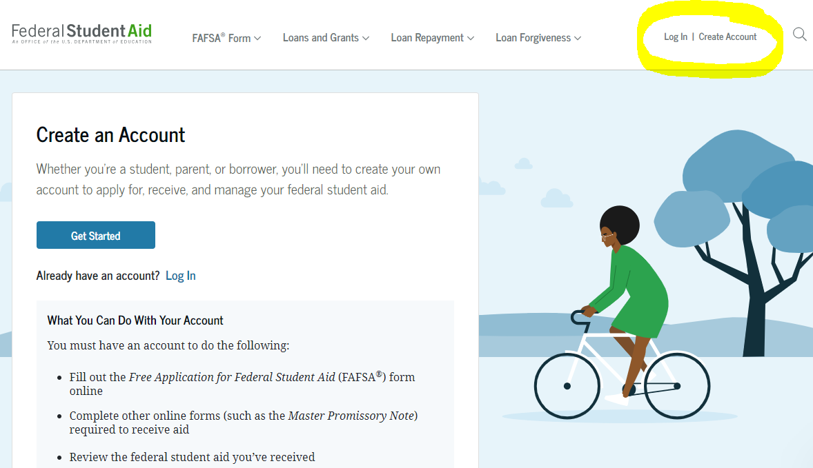
Meeting college and state deadlines can make a difference in the amount of aid a student receives so file ASAP
https://studentaid.gov/fsa-id/create-account/launch

